Slide 1
Random Number Generator
Using file as entropy source
by
Jay Bhatt
&
Krishna Kant Singh

Slide 2
Introduction
Random number generator is a function which generates a sequence of numbers that cannot be reasonably predicted.
RNG are classified in 2 types:
PRNG
Pseudo RNG.
Depends on an algorithm and a seed.
Sequence can be recreated with same seed.
TRNG
True RNG.
Takes values from entropy present in environment.
Can be biased, either Software Whitening is used, or the value is used as a seed with a PRNG.

Slide 3
Application
Cryptography
Monte Carlo simulations
Gaming and gambling
Artificial intelligence

Slide 4
Problem Statement
“To develop a reliable random number generator which can generate a random sequence which cannot be predicted by an attacker.”
Currently we have many systems which generate random numbers. However, many of them depend on a seed and if presented again with the same seed, will recreate the same sequence. Many true random number generators exist as well, but they either only generate a seed or have an inherent bias. We aim to create a random number generator which does not depend on an input seed from user, and hence does not recreate a sequence.

Slide 5
Approach
We accept files from various clients and store them as encrypted files in our database.
These files are then used as source of random data and are enqueued.
When a user asks for a number, we check if –
Their token is valid.
They have uploaded enough data.
After the check is done, we deque some amount of data (as provided in API request argument) and serve the random number accordingly.

Slide 6
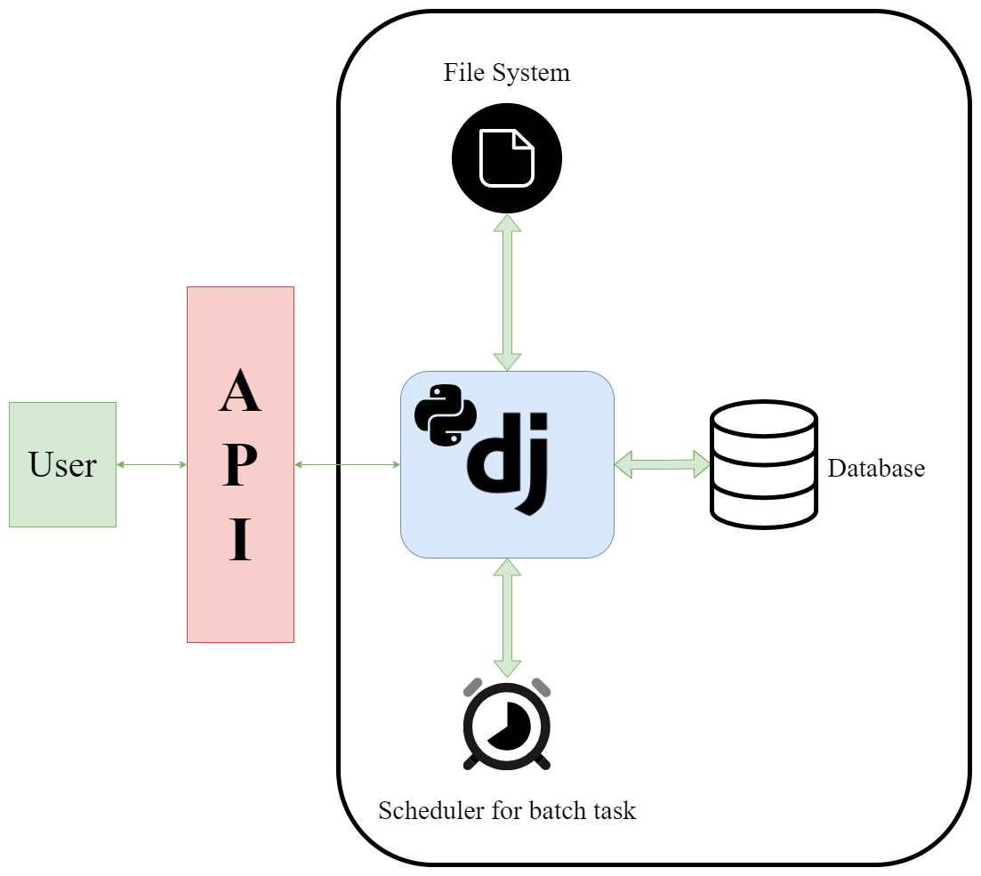
Logic Diagram

Slide 7
Technologies used
Django Web Framework
Python
SQLite3 as database
pip as package manager
Python modules such as cURL, requests, cryptography, etc.
Python venv for a virtual environment
Advanced Python Scheduler (APScheduler) to schedule various scripts

Slide 8
Randomness Tests
Statistical test : A statistical test, also known as a hypothesis test, is a procedure used to make an inference or draw conclusions about a population based on a sample of data.
Chi-squared test : The chi-squared test is a statistical test used to determine whether there is a significant difference between observed data and expected data, assuming a specific null hypothesis. It is commonly used to assess the goodness-of-fit of a distribution or to test for independence between variables.
Diehard tests : The Diehard tests are a battery of statistical tests designed to assess the quality and randomness of random number generators.

Slide 9
Features

Slide 10
Models
Models are stored in SQLite3 database.
The following models are used in our project –
Token
Token – a unique token provided to user (Primary key).
Data – amount of data that can be redeemed by the user.
Exp – expiry date of the token.

Slide 11
Token
Users verify themselves by completing a captcha.
If successful, user is presented with a Token_id.
Django-simple-captcha is used for captcha implementation.

Slide 12
Generate
API endpoint located at “/api/generate/”.
Request format contains following fields –
Token – token generated by visiting “/token/”.
Size – number of bytes required by user.
If request is valid, user is presented with a random number of requested size.
If request is invalid, user is presented with error response describing error occurred.

Slide 13
Upload
API endpoint located at “/api/upload/”.
Request format contains following fields –
File – file data.
Token – token generated by visiting “/token/”.
If successful, user gets a success response and file is uploaded.
Else user gets an error response with brief description of error.

Slide 14
Balance
API endpoint located at “/api/balance/”.
Request format contains following fields –
Token – token generated by visiting “/token/”.
If successful, user gets a success response along with size up to which a user can generate random numbers from the API without adding new data.
Else user gets an error response with brief description of error.

Slide 15
Scheduler
APScheduler is used to schedule scripts.
Following scripts are scheduled in our project –
Fast crypt – this job encrypts various files and stores them in the encrypted section of file system.
Auto token deletion – this job is run to remove all tokens which have exceeded their expiry date.

Slide 16
Screenshots and Demo

Slide 17
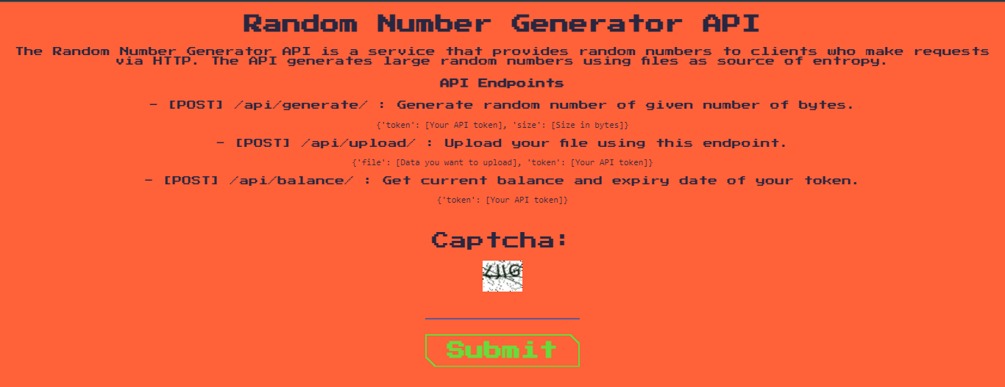
Index page

Slide 18
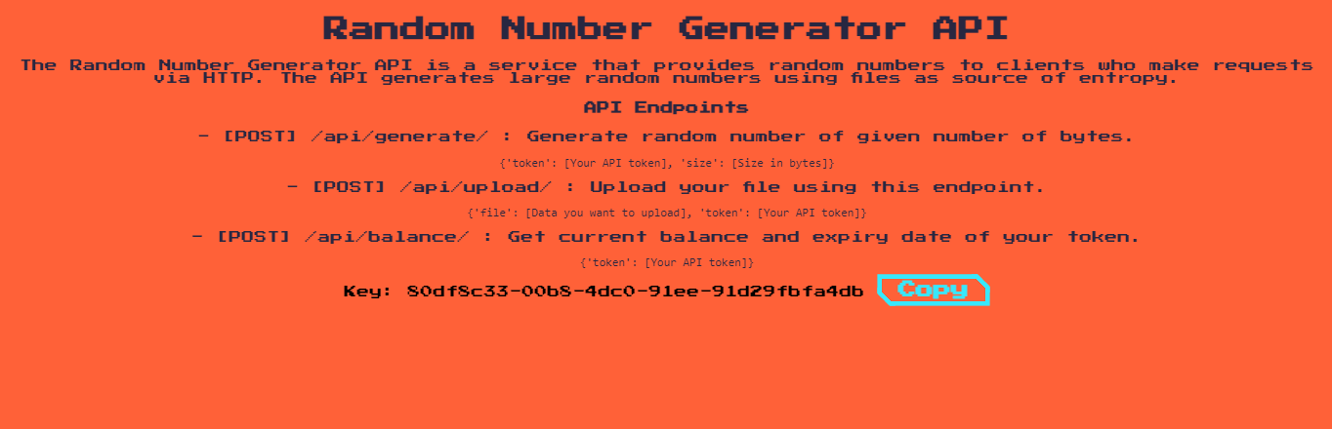
Token generation page

Slide 19
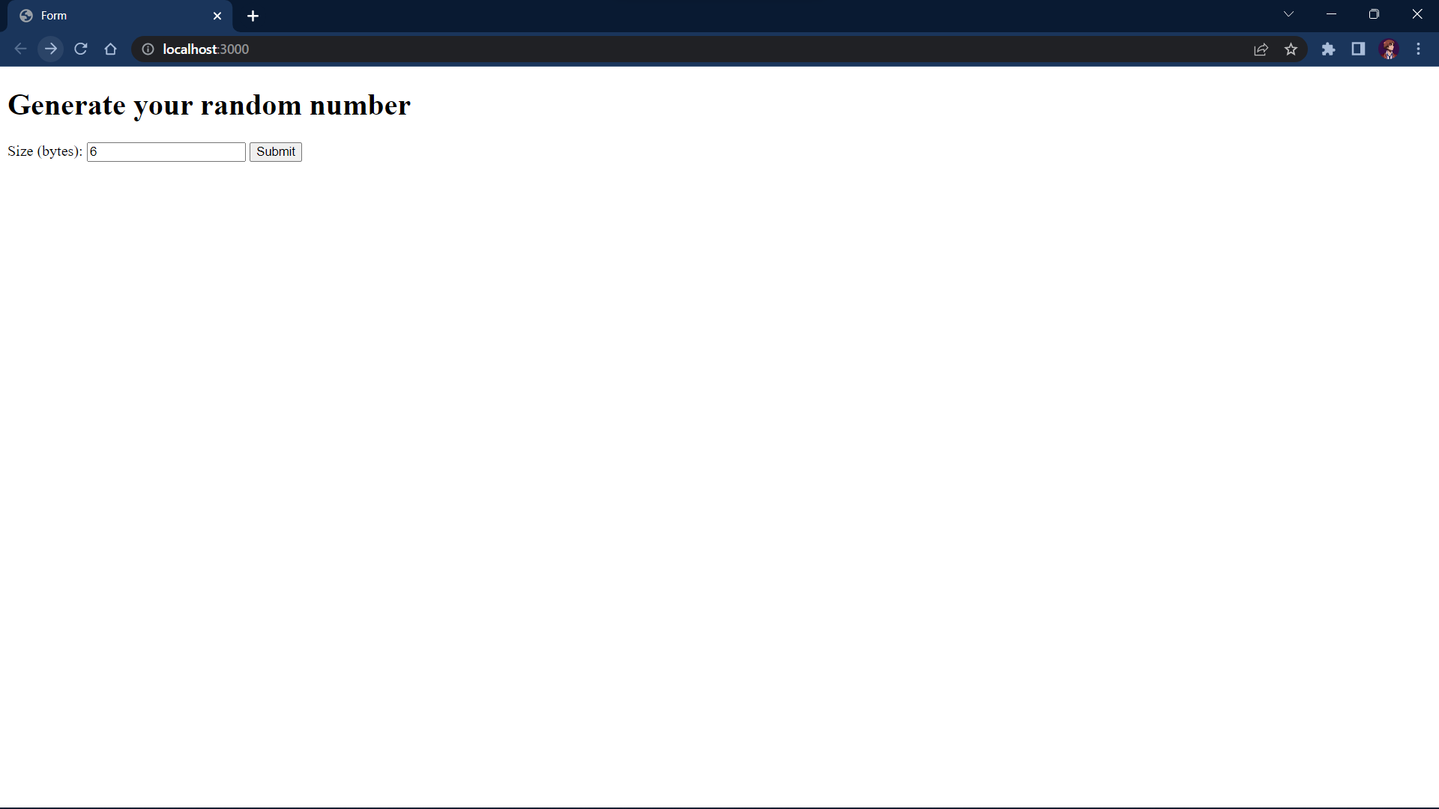
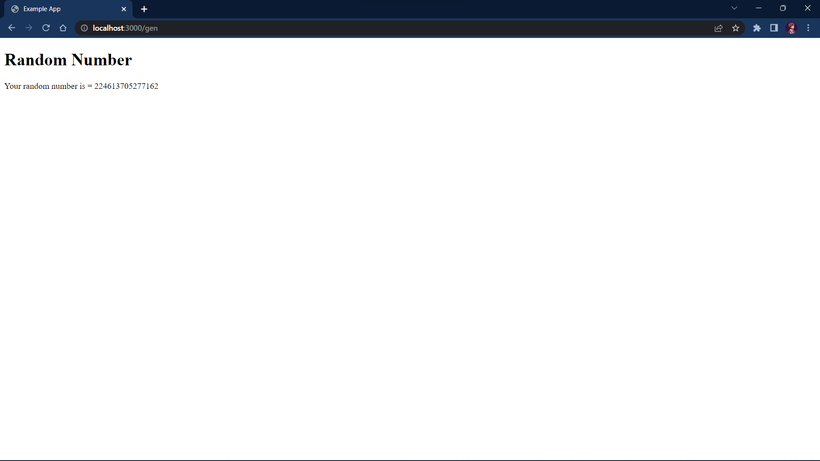
API Implementation Example

Slide 20
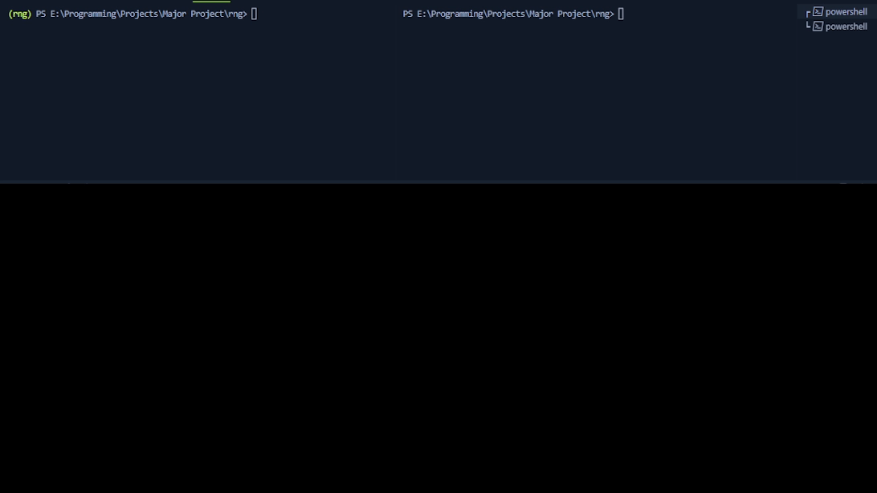
Demo

Slide 21
Future works
Create a dedicated File System for handling encrypted file for optimized Read/Write operations.
Implement the project as a micro service.
Optimize generation time for random data.

Slide 22
Thank You

